Slide 1
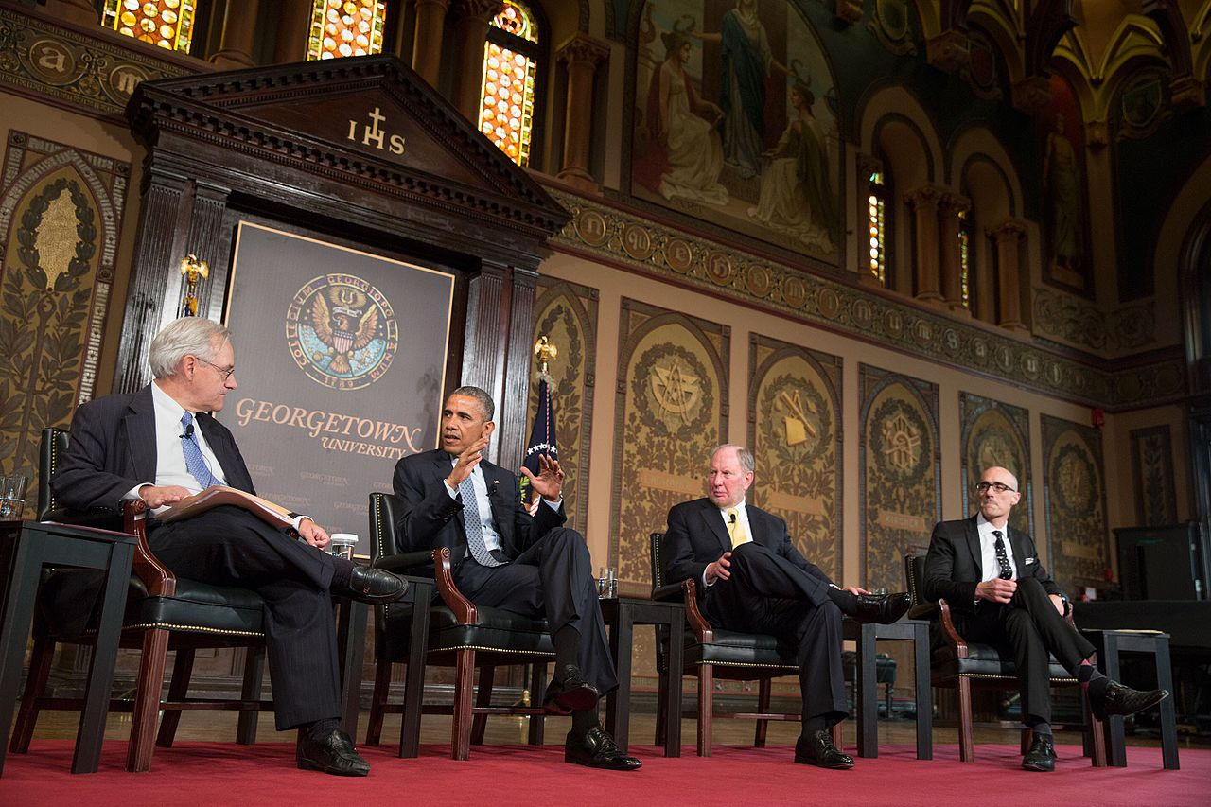

FinApp 2019

Slide 2
“Keep them coming, all of them — the radicals, the politicians, the spiritual leaders and whoever else can be roped into speaking here. To continue the Jesuit ideal of lifelong, comprehensive learning, our minds need to be challenged, inspired and opened.”
-THE HOYA
Notes:
The importance of LF

Slide 3
Lecture quality is like intelligence. Ask 10 people for a definition and get 10 different answers; but most people will know it when they see it.
–FORMER LF CHAIR

Slide 4
WHAT WE DO

Slide 5
MISSION
The Georgetown University Lecture Fund is a non-partisan student-run organization that exists to enrich the academic experience of the Georgetown community. We strive to bring speakers to Georgetown's campus to enlighten, educate and, occasionally, entertain.

Slide 6
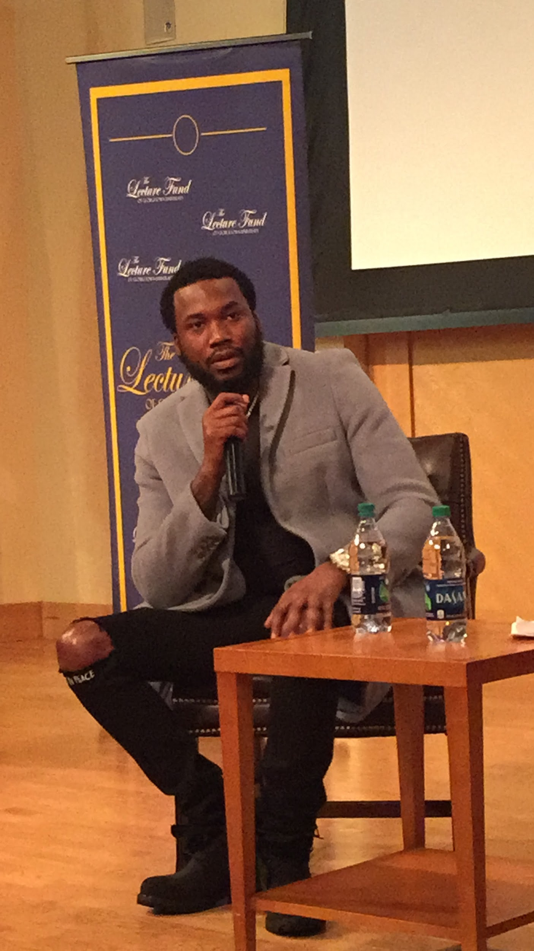
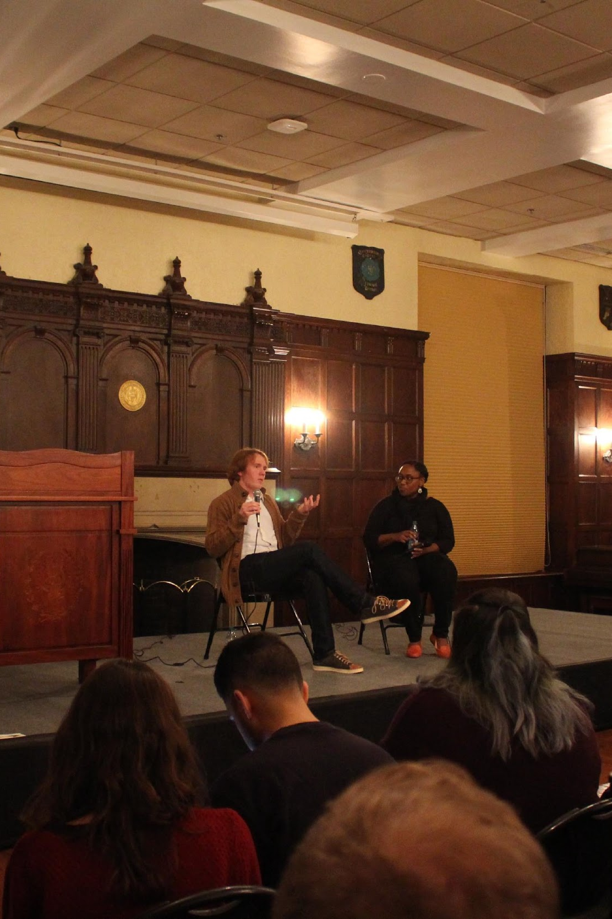
TYPE 1:
ORIGINAL LECTURES

Slide 7
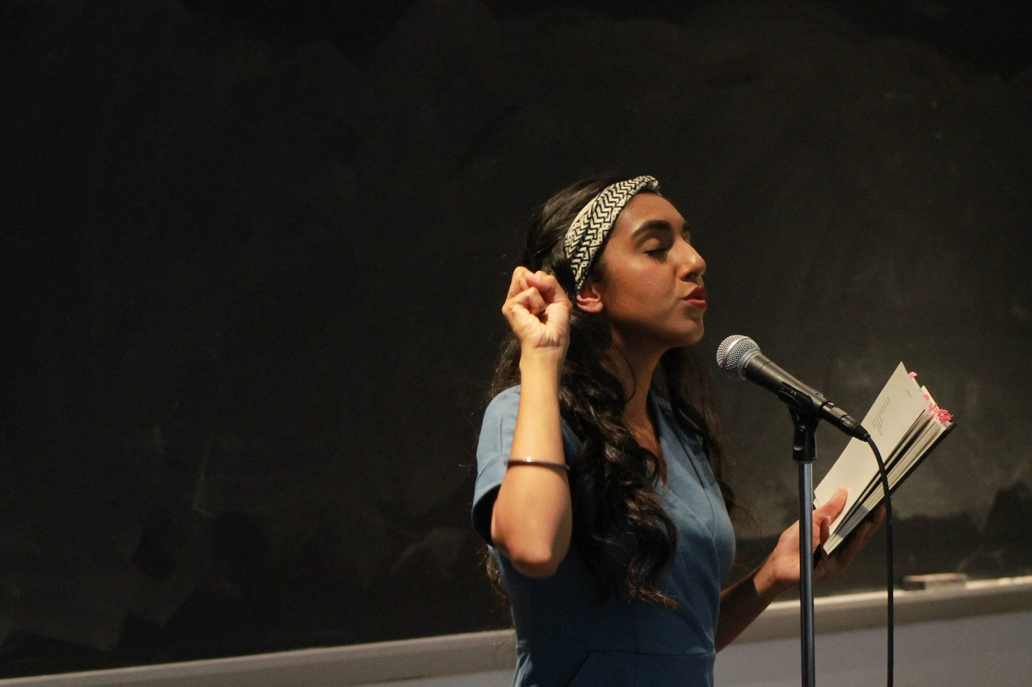
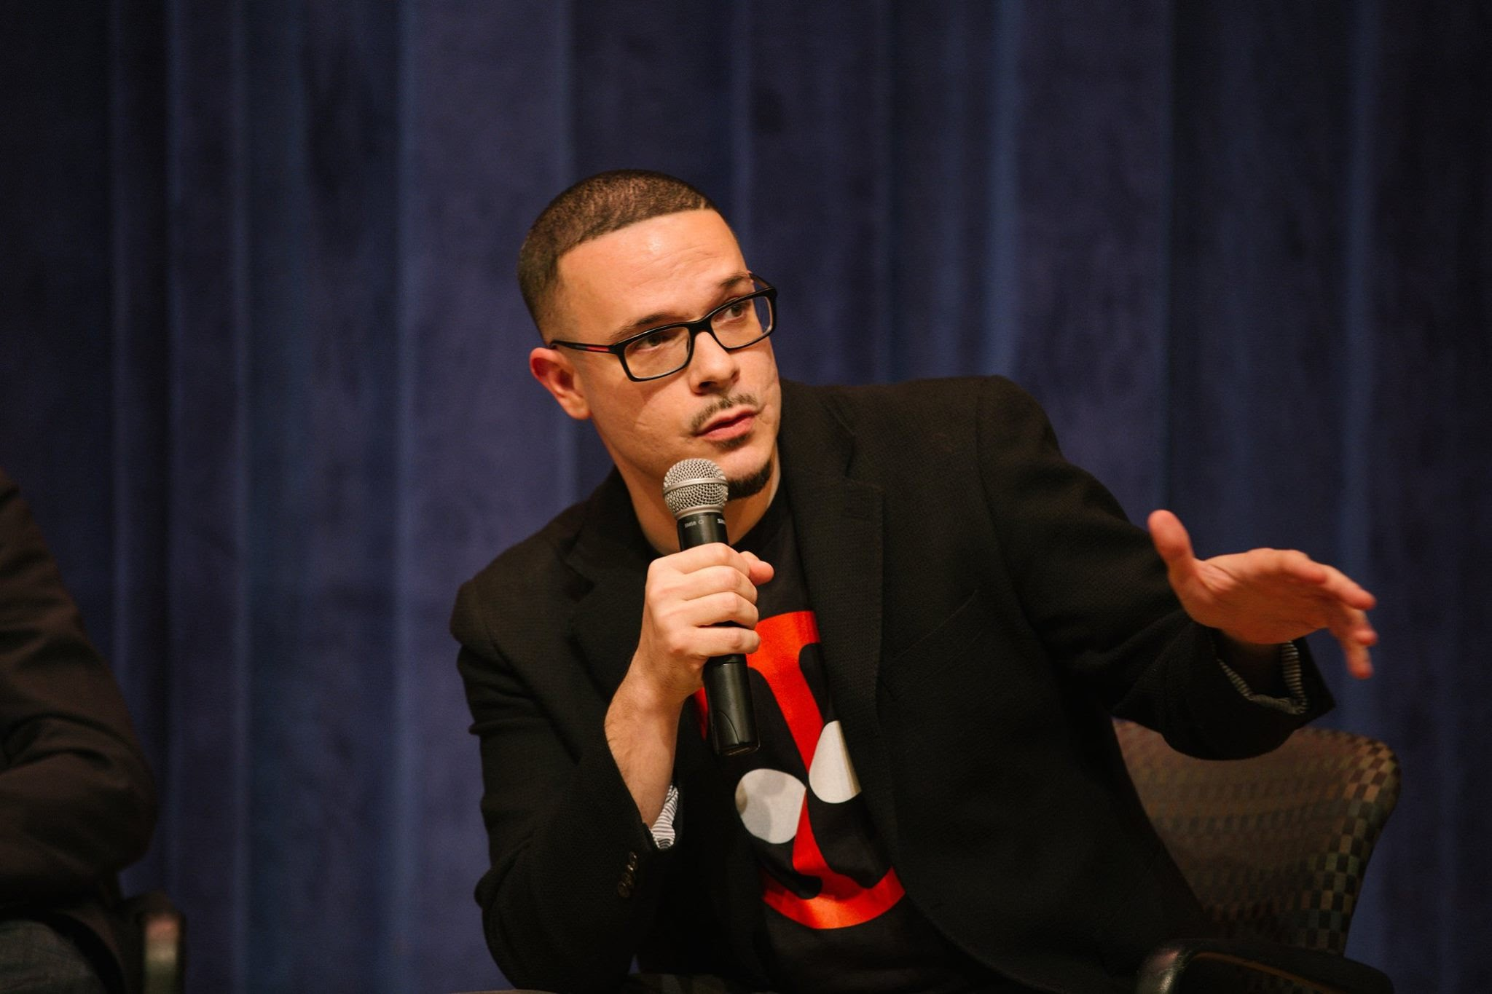
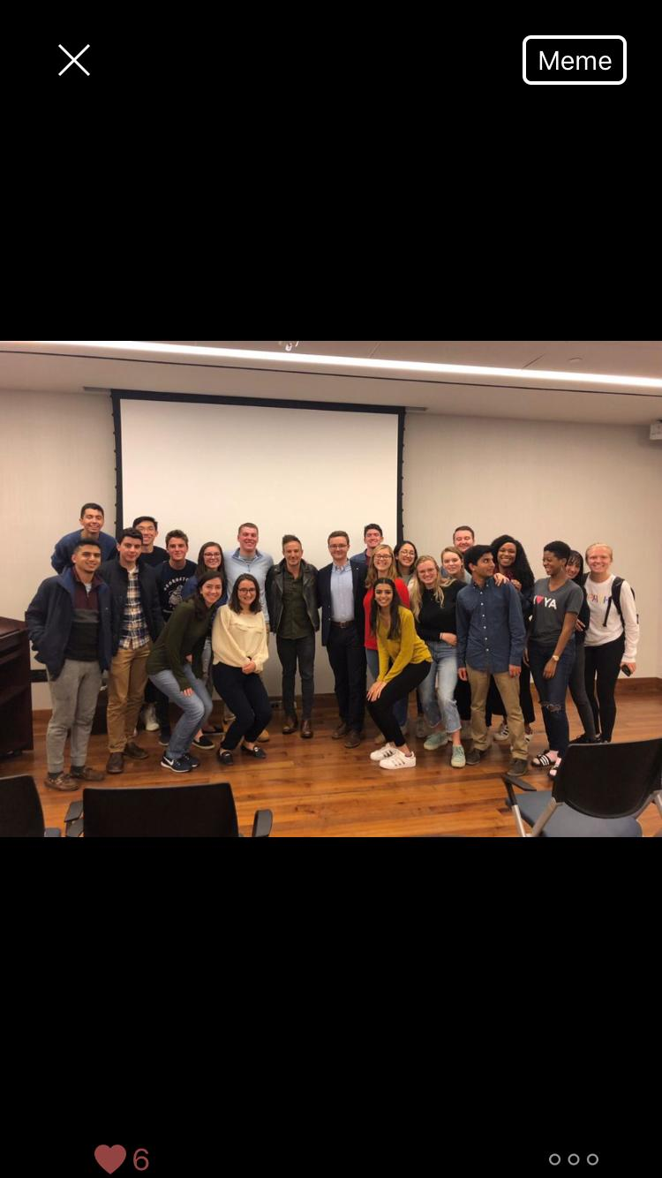
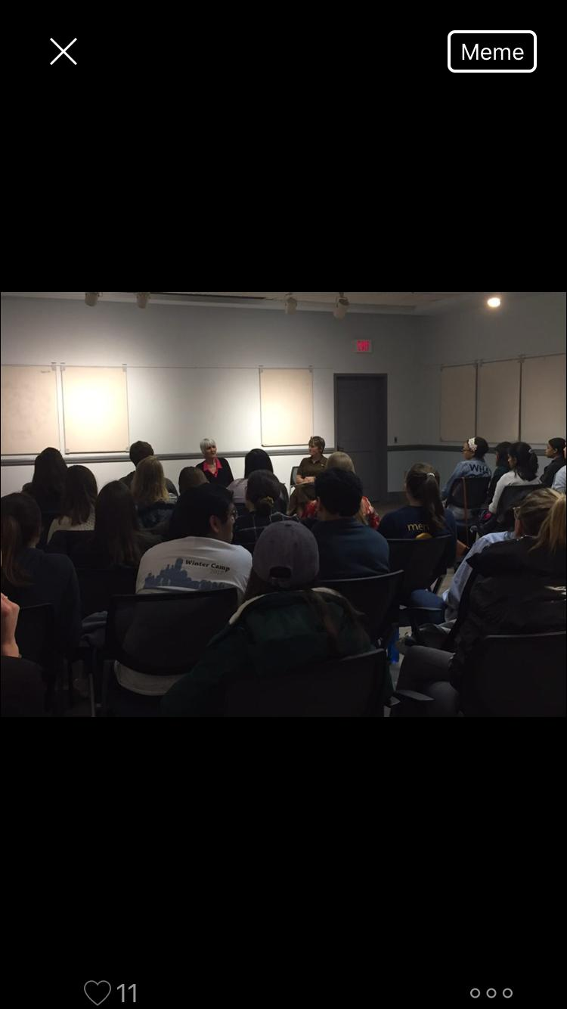
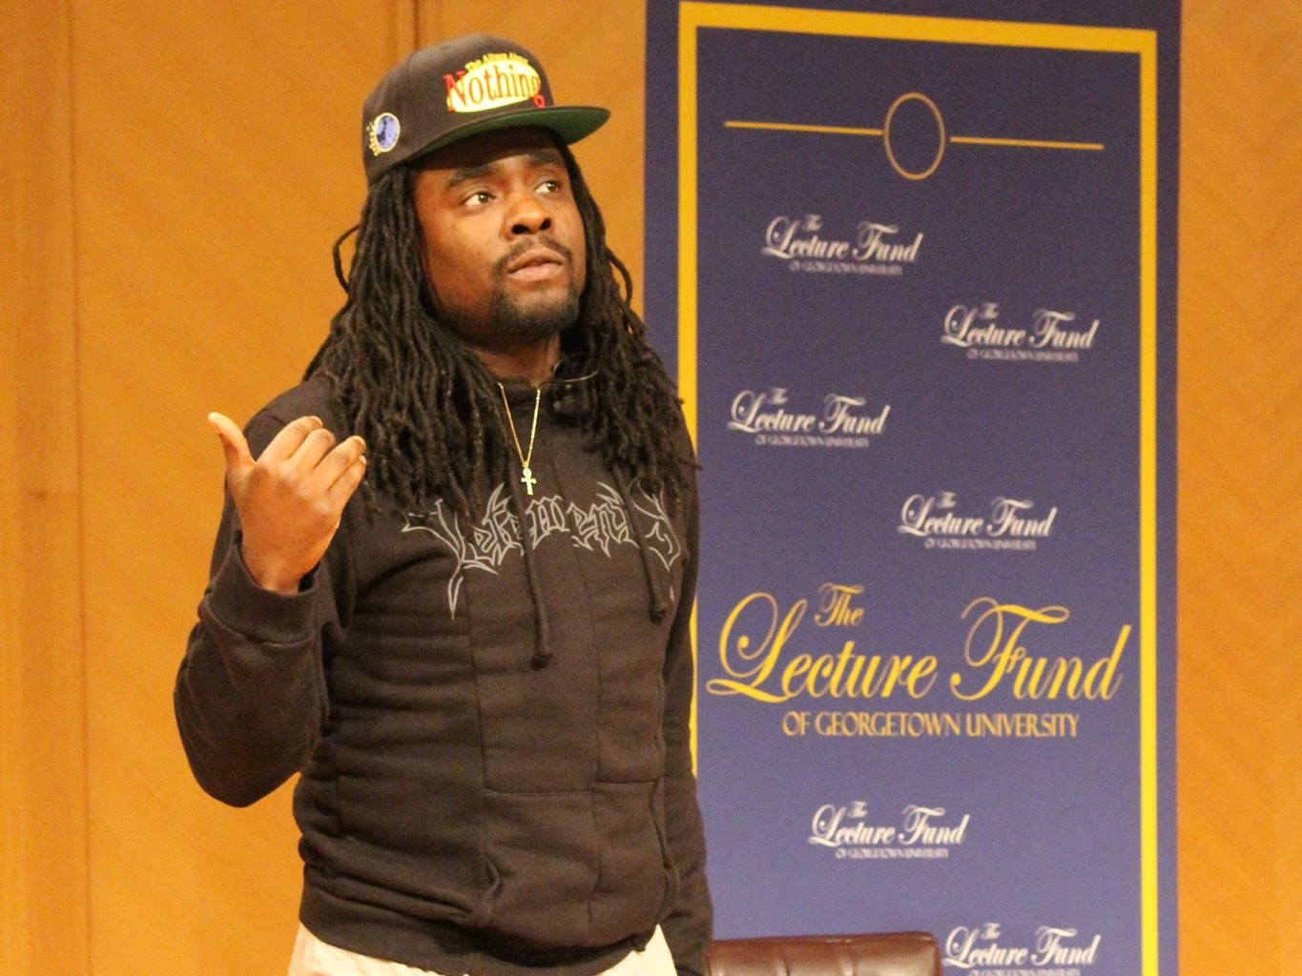

Slide 8
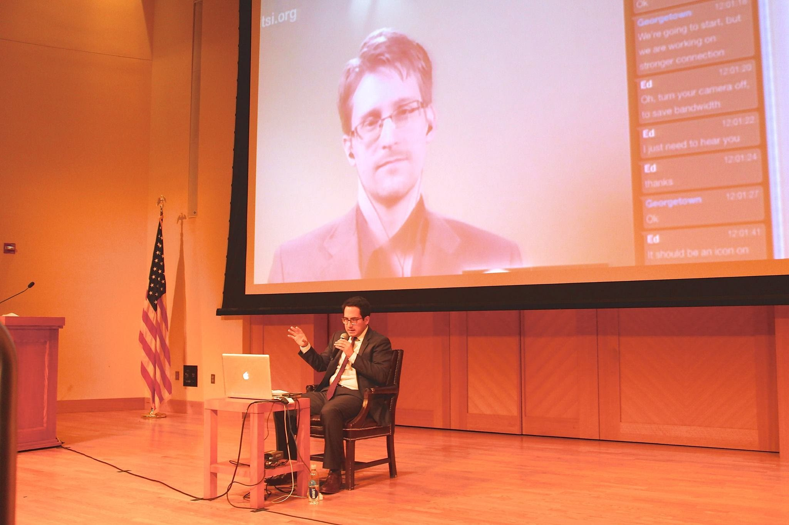
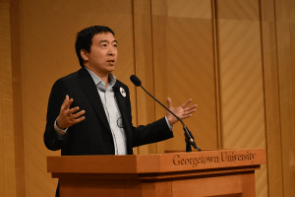
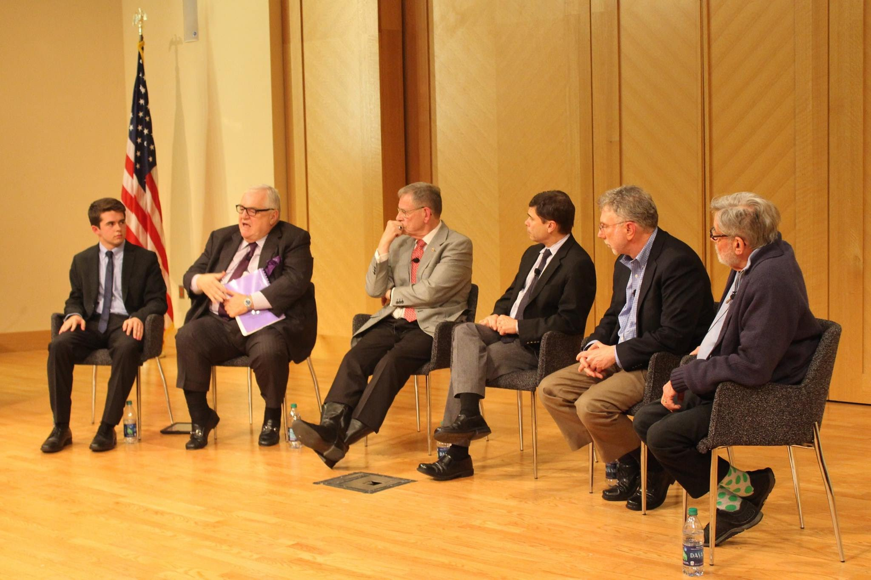
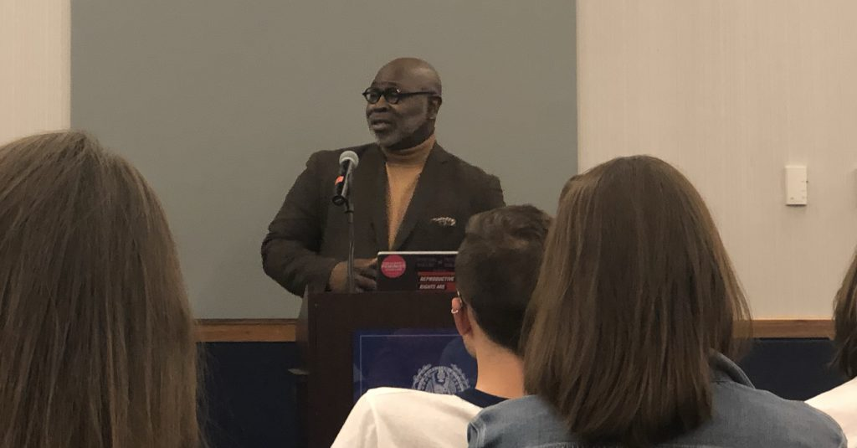
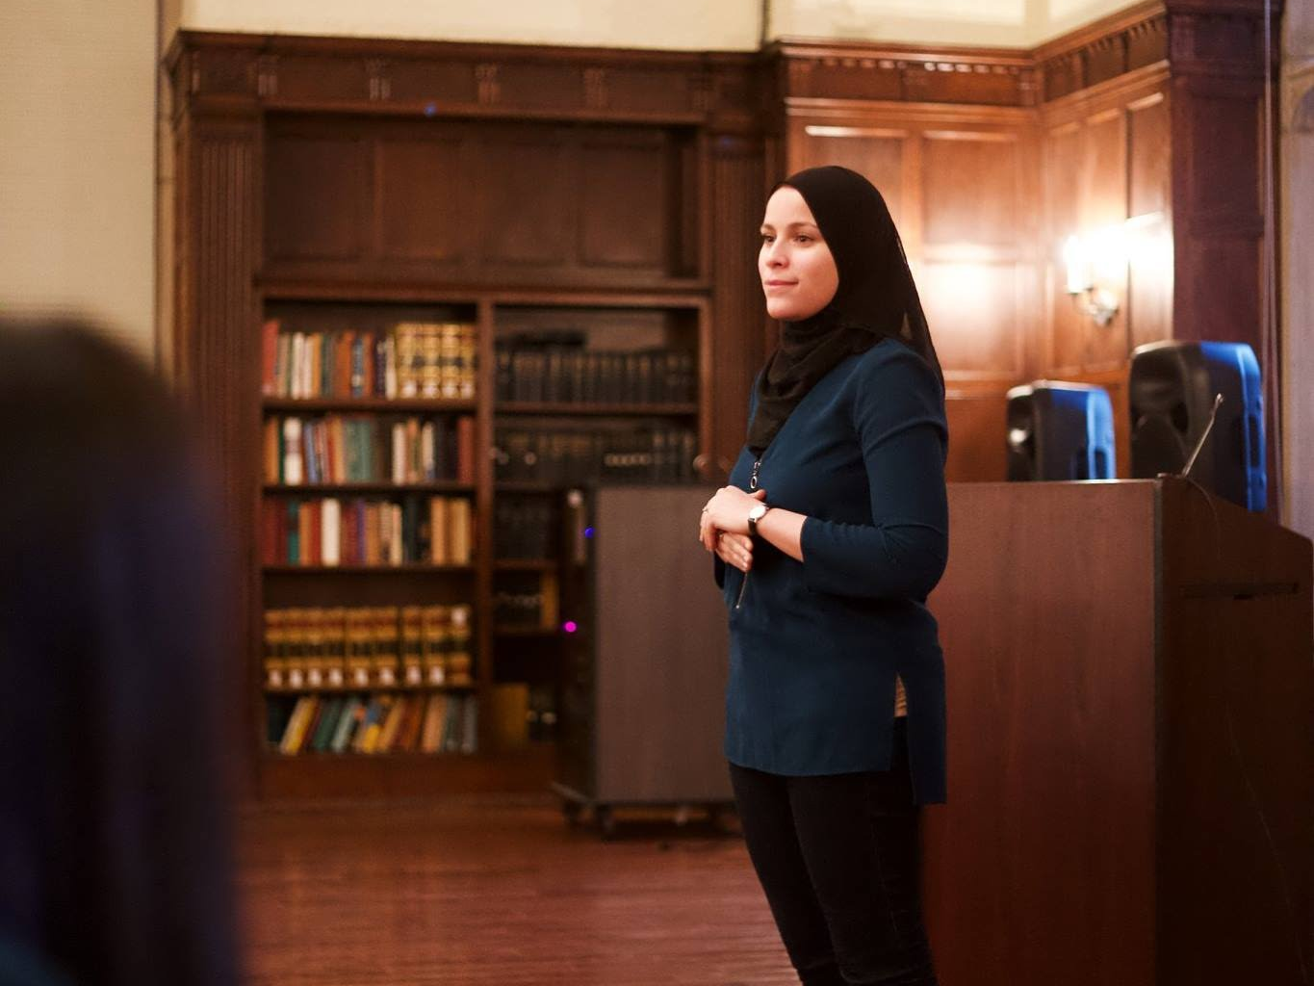

Slide 9
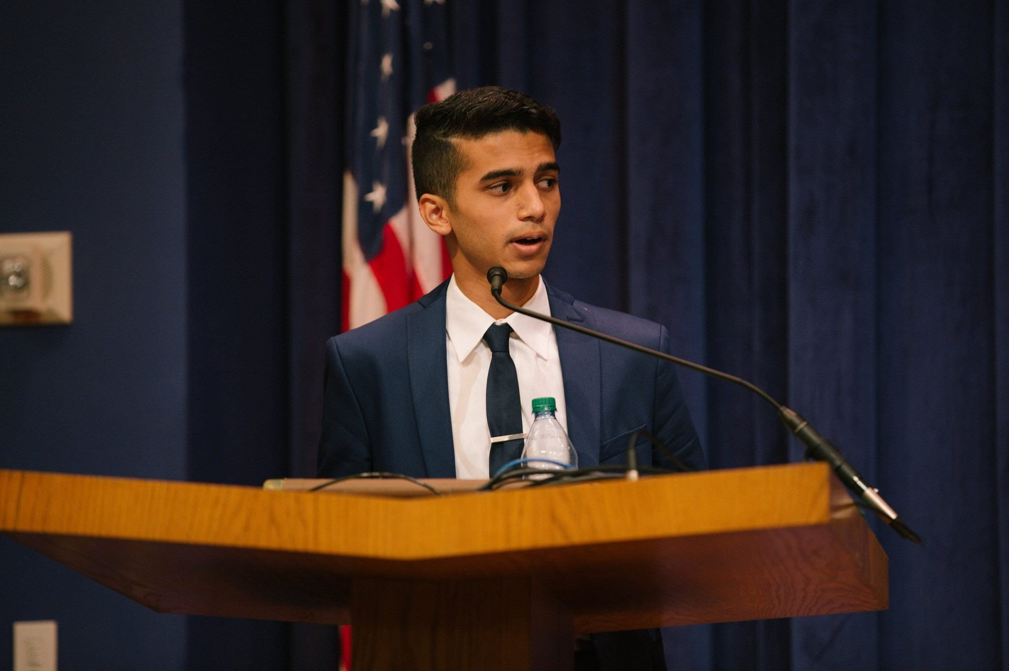
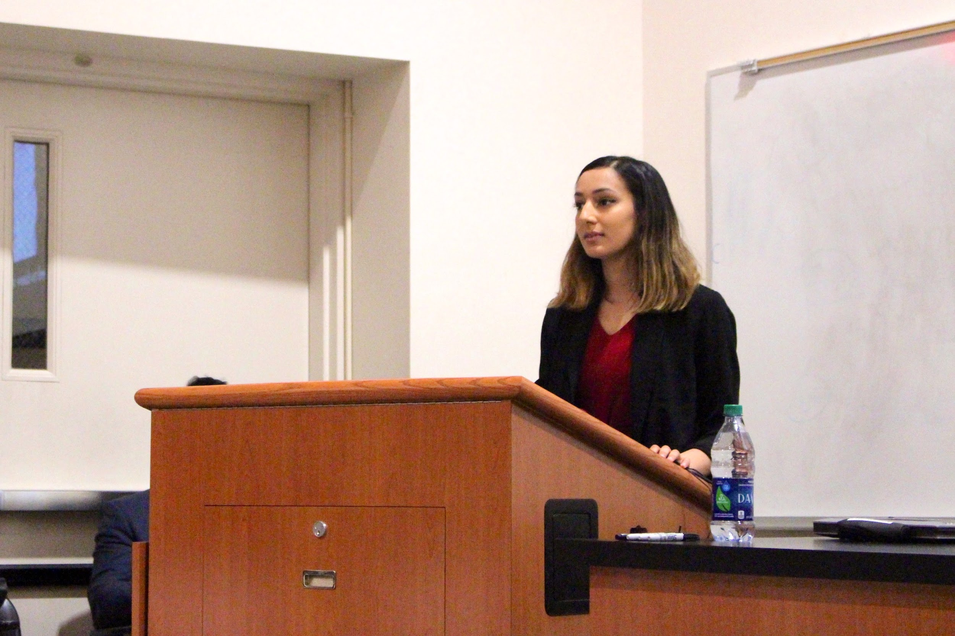
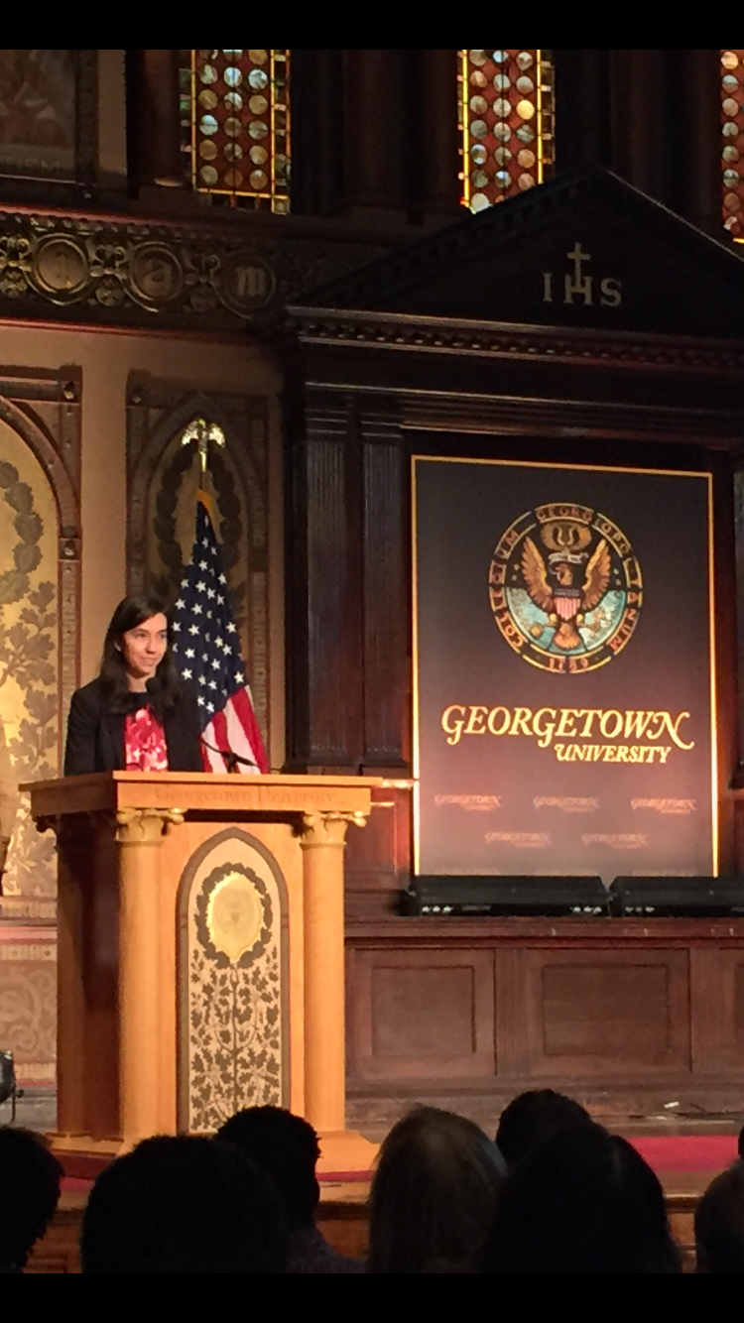
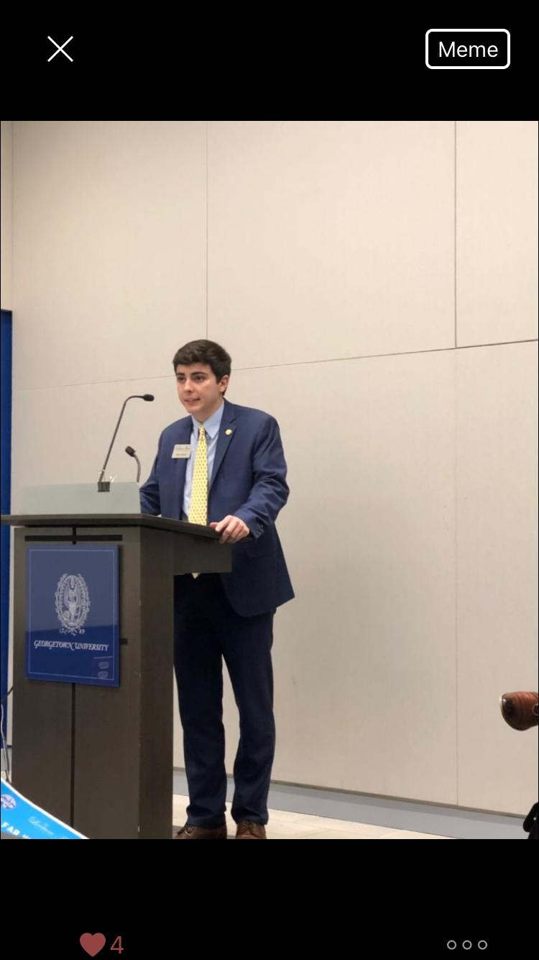
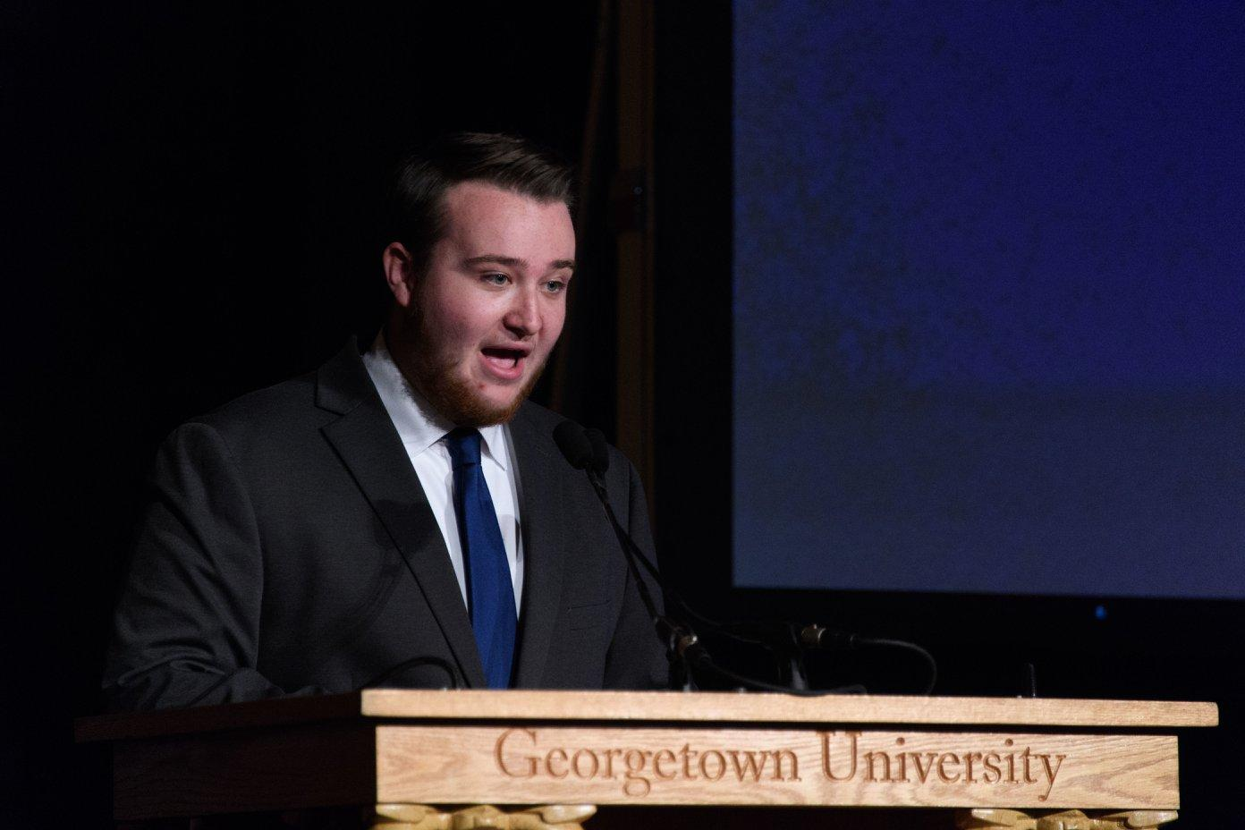

Slide 10
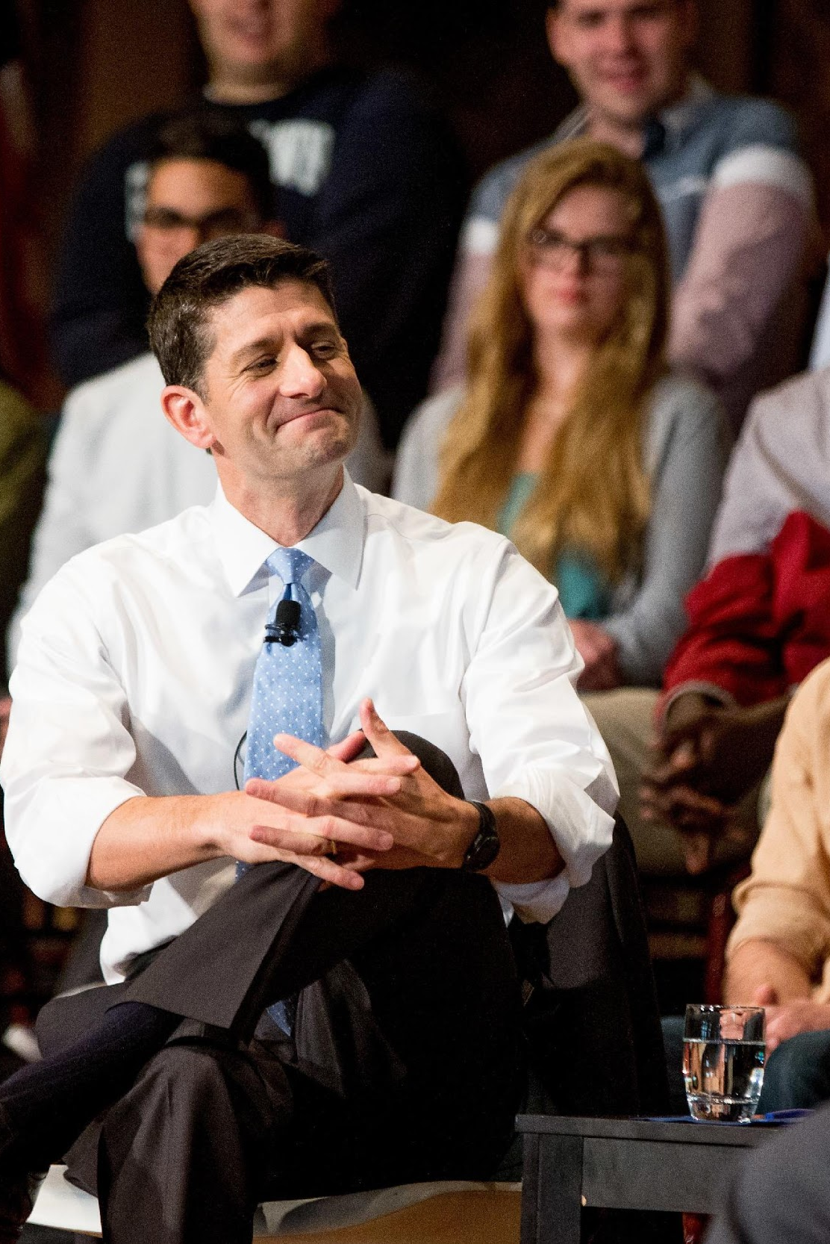
TYPE 2:
PRESIDENT’S OFFICE
Notes:
Grace

Slide 11
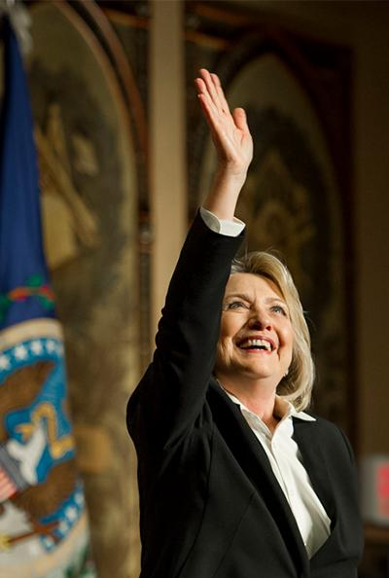
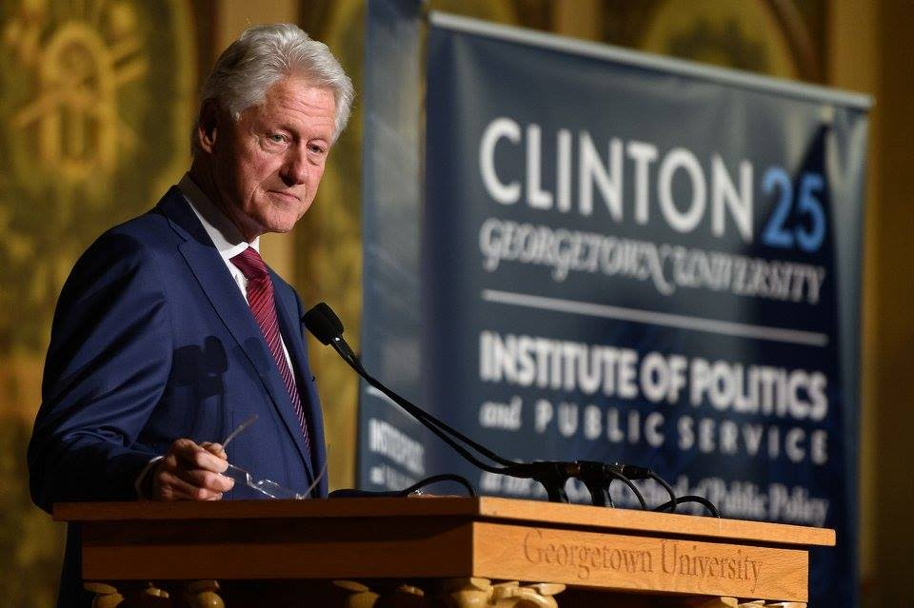
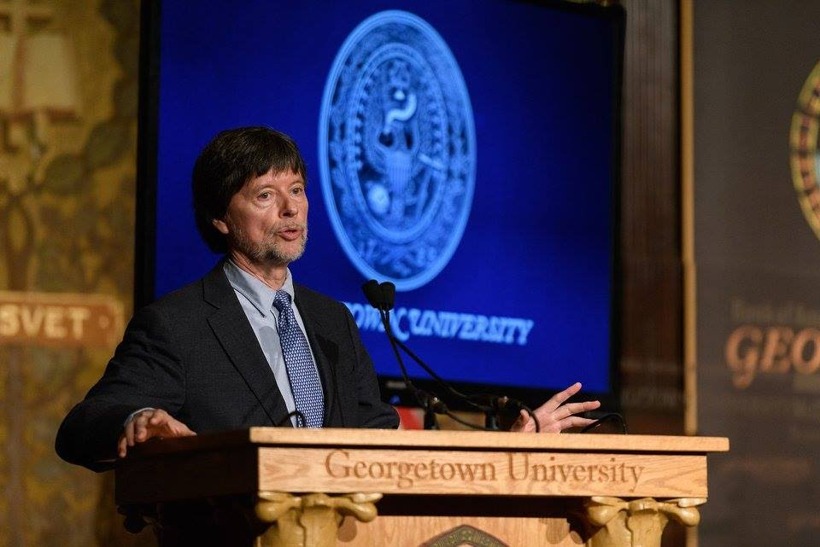
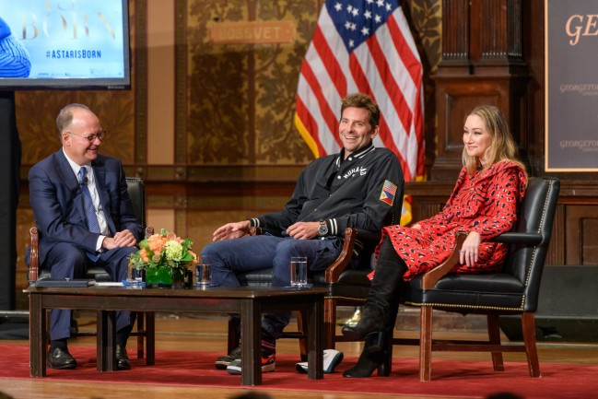
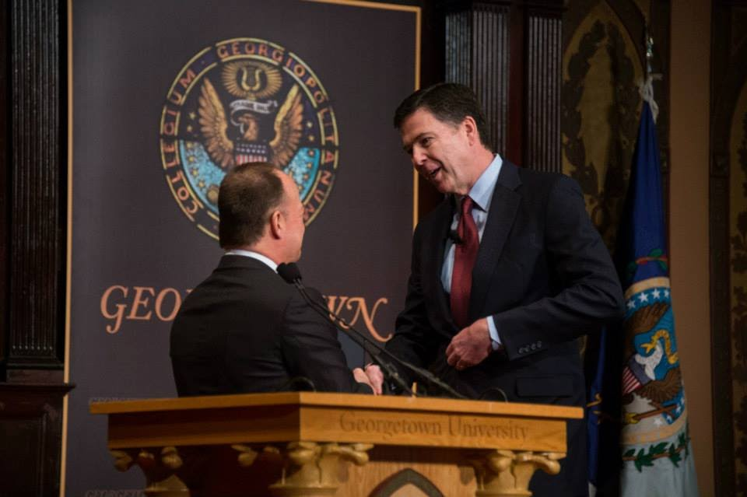
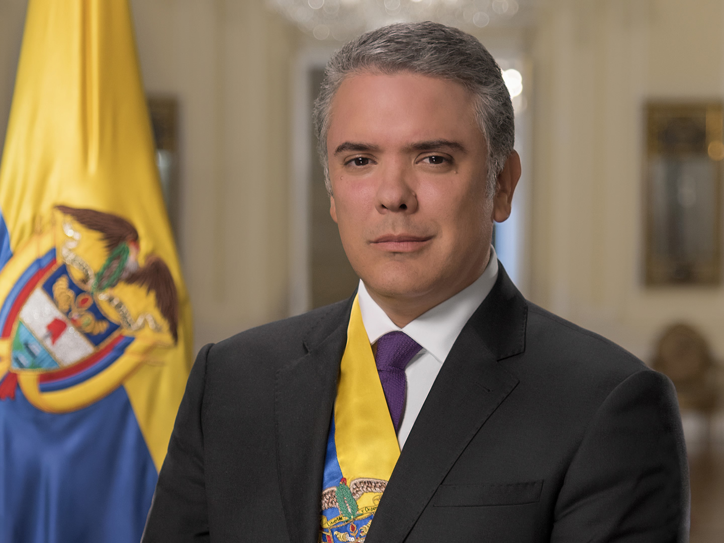

Slide 12
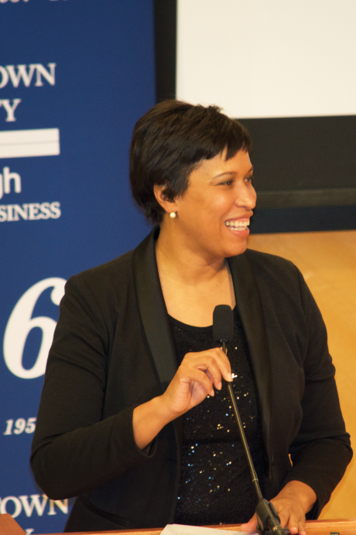
TYPE 3:
COSPONSORING
Notes:
Nicole

Slide 13
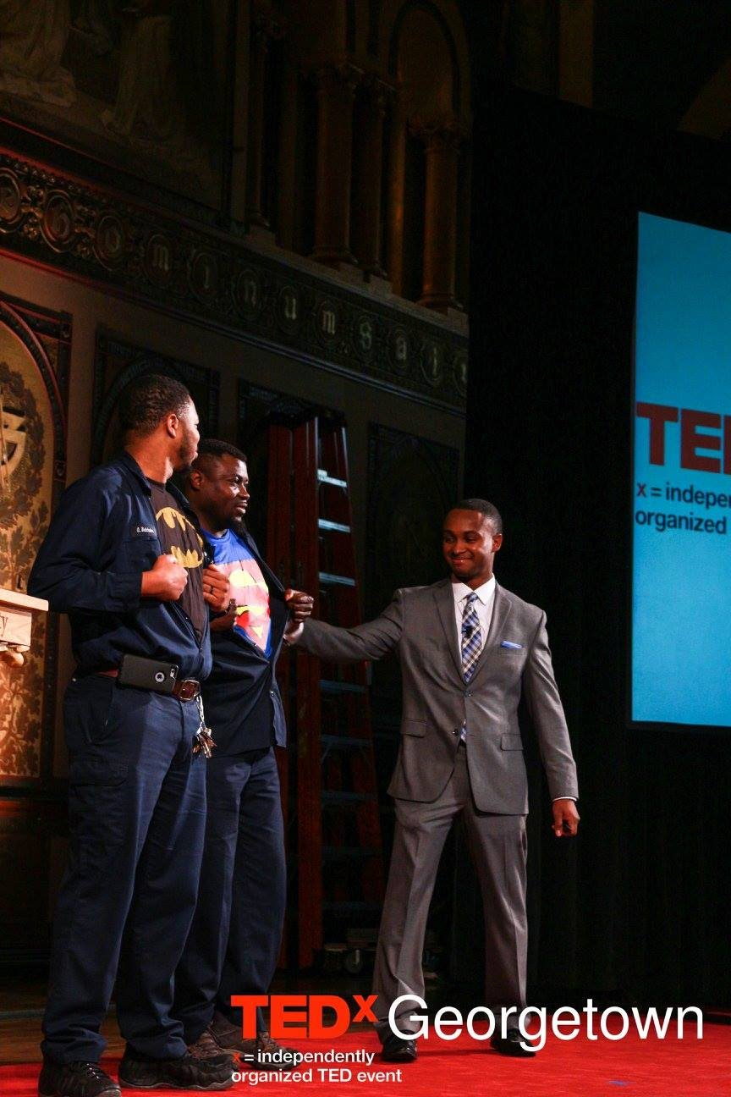
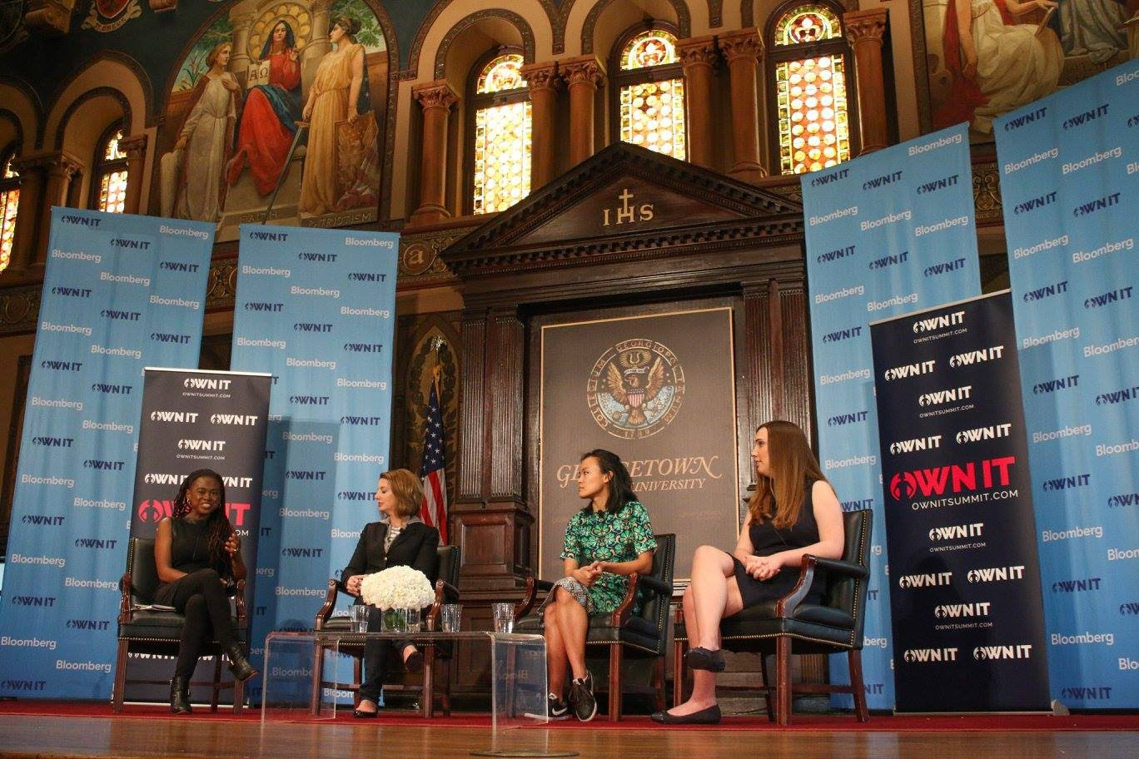
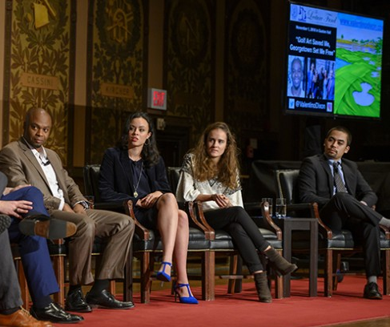
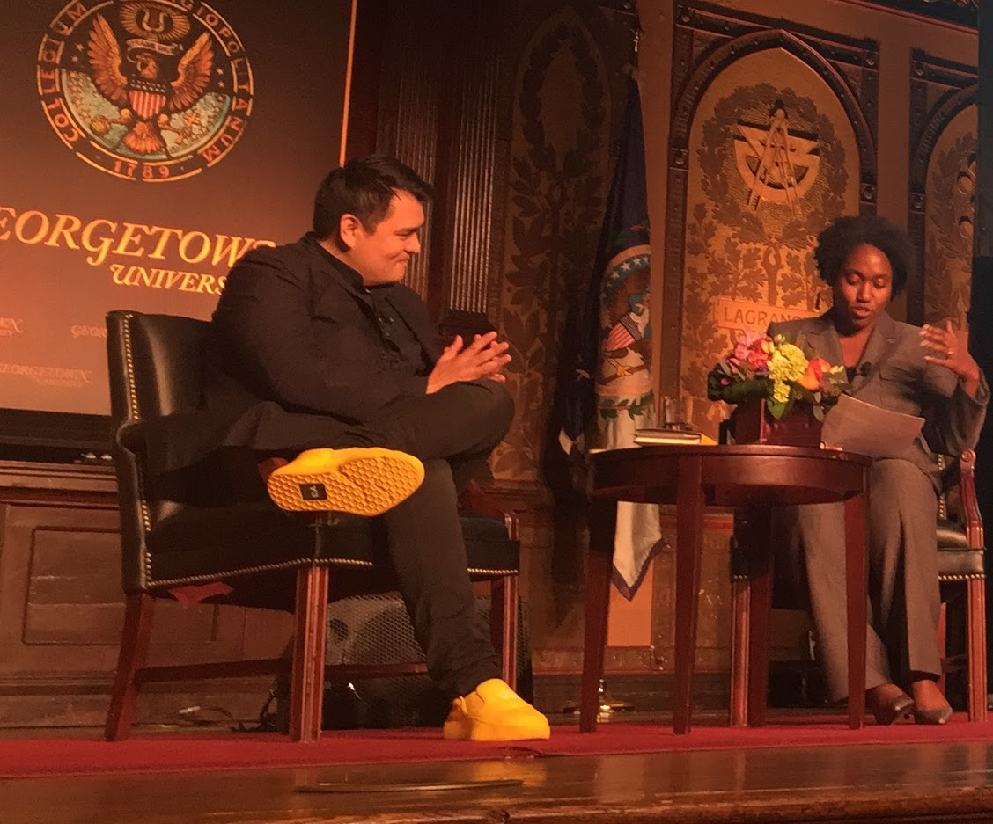
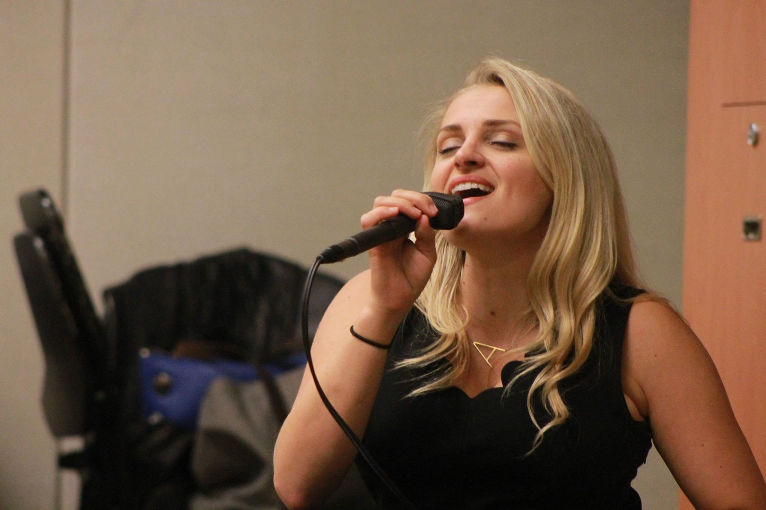

Slide 14
Co-Sponsorship Requests
FY18: $24,500 requested & $17,500 allocated
FY19:$62,112* requested & $23,922 allocated
FY19: 14/17 organizations at least partially funded so on average we contribute $1,708 to every organization
*Please note the increase from our application submitted February 10, 2019 from $47,112 to $62,112 as we received an additional $15,000 in request at our February 12, 2019 Board meeting

Slide 15
Examples of Co-Sponsors
FY18:
GU Pride
Prison Justice Initiative
Caribbean Culture Circle
Center for Jewish Civilization
GU College Republicans
Center for Social Justice
BRAVE summit
Georgetown Israel Alliance
Hoyas for Choice
Muslim Student Association
FY19:
Beeck Center
UndocuHoyas
Knights of Columbus
Relay for Life
GU College Democrats
Free Speech Project
Working to End Rape Culture Summit
JUPS
Lannan Center for Poetics and Social Justice
Cardinal O’Connor Conference on Life

Slide 16
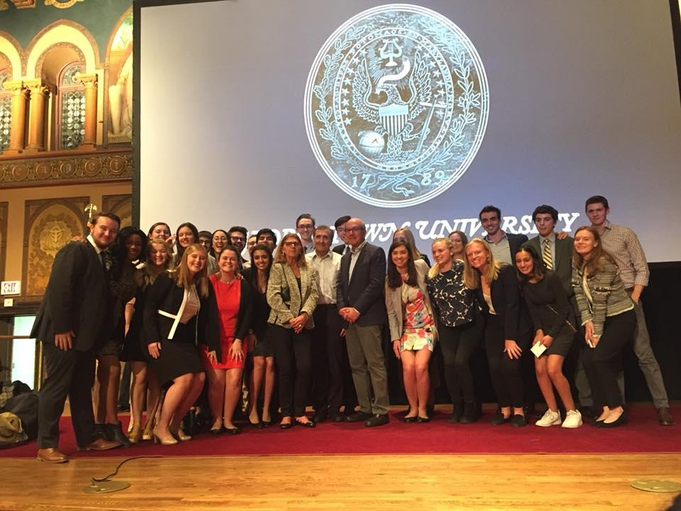
WHO WE ARE
Notes:
Michael -- associate board

Slide 17
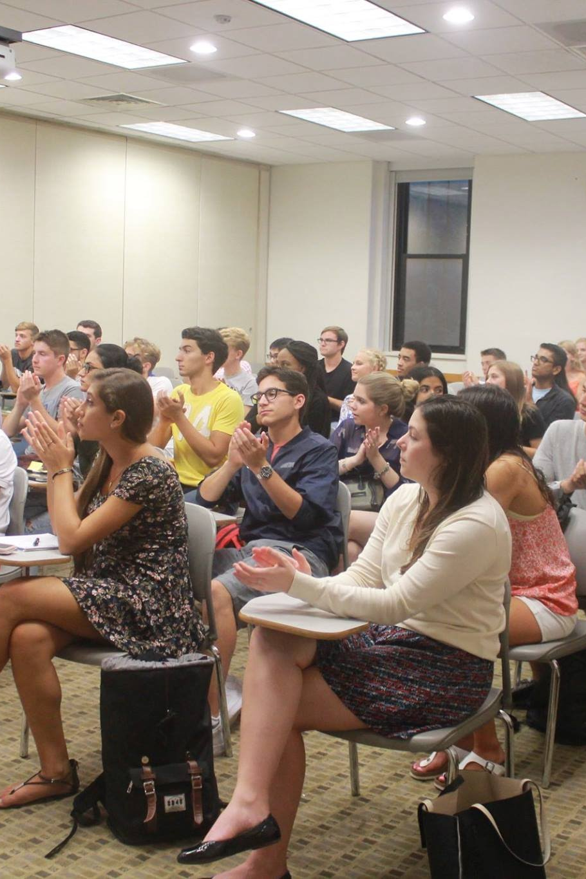
GENERAL BODY
Notes:
Michael

Slide 18
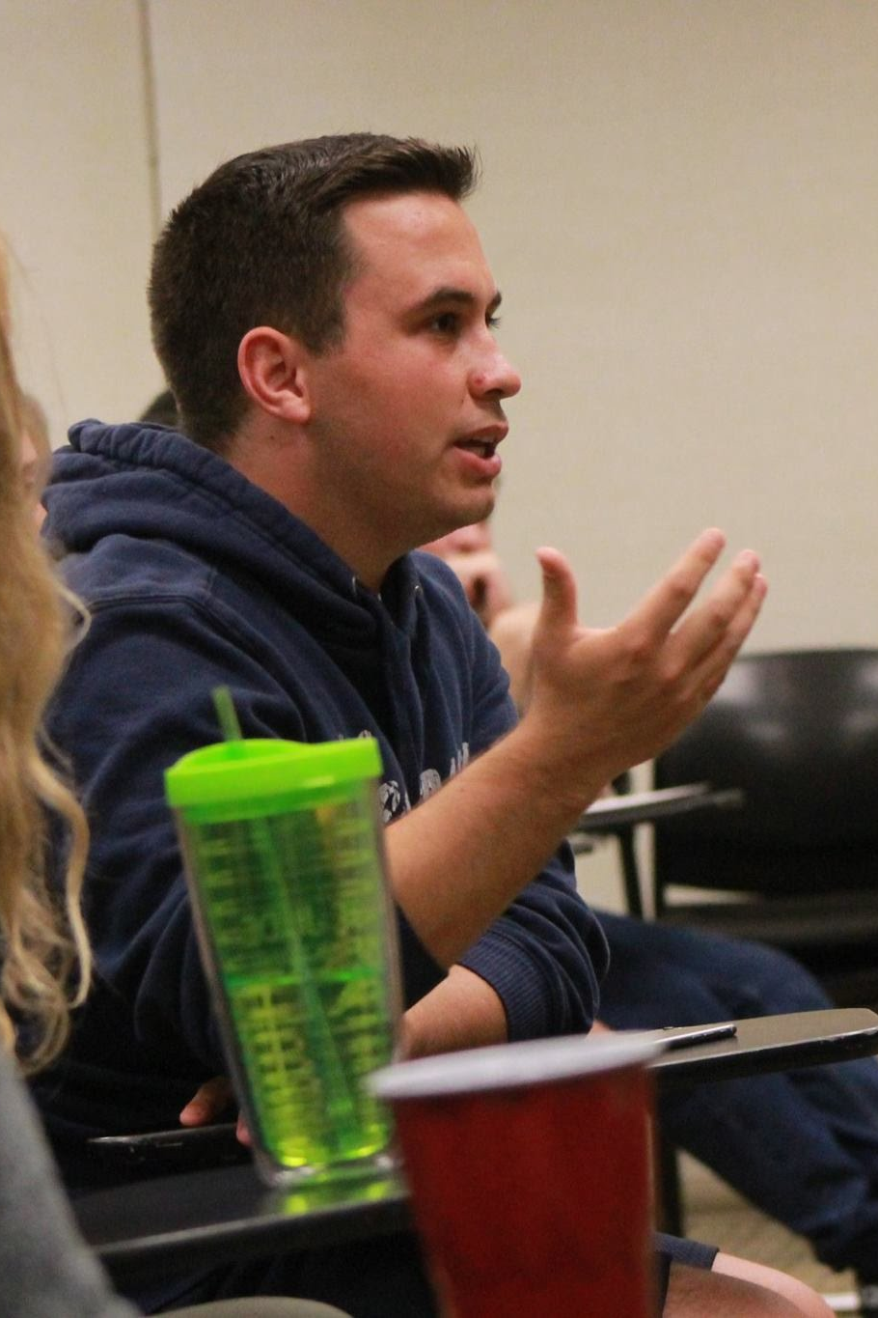
GENERAL BODY
Why We Created It
The Goal and Function
“Taste of Georgetown”

Slide 19
QUESTIONS

